Slide 1

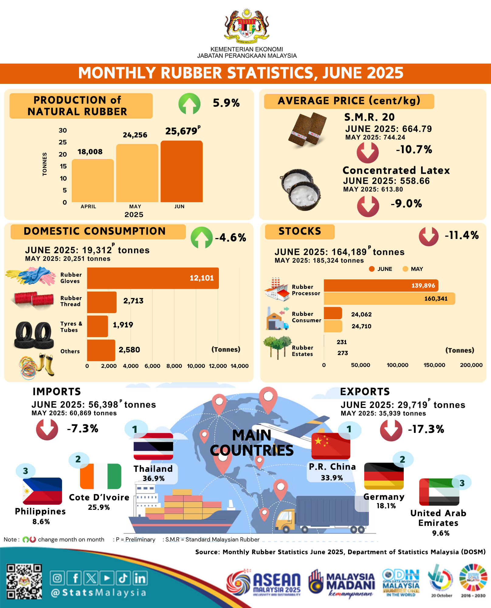

12 AUGUST 2025 | #174
MONTHLY RUBBER STATISTICS, JUNE 2025
Imej Infografik (BI)
Crop hanya part ‘data’ sahaja
Maksimumkan penggunaan ruang
PRINCIPAL STATISTICS OF RUBBER, MALAYSIA (‘000 TONNES)
(‘000 tonnes)
(‘000 tonnes)
(‘000 tonnes)
(‘000 tonnes)
Production
Domestic Consumption
Import
Export
1

Slide 2

12 AUGUST 2025 | #174
Malaysia natural rubber production increased by
5.9 per cent in June 2025
Natural Rubber (NR) production increased by 5.9 per cent in June 2025 (25,679 tonnes) as compared to May 2025 (24,256 tonnes). Year-on-year comparison showed that the production of NR decreased by 14.1 per cent (June 2024: 29,881 tonnes). Production of NR in June 2025 for Malaysia was mainly contributed by smallholders sector (84.7%) as compared to estates sector (15.3%).
Total stocks of NR in June 2025 decreased by 11.4 per cent to 164,189 tonnes as compared to 185,324 tonnes in May 2025. Rubber processors factory contributed 85.2 per cent of the stocks followed by rubber consumers factory (14.7%) and rubber estates (0.1%).
Exports of Malaysia's NR amounted to 29,719 tonnes in June 2025, decreased 17.3 per cent as against May 2025 (35,939 tonnes). P.R. China remained as the main destination for NR exports which contributed 33.9 per cent of total exports in June 2025 followed by Germany (18.1%), the United Arab Emirates (9.6%), the United States of America (7.3%) and India (3.8%).
The average monthly price showed that Concentrated Latex recorded a decrease of 9.0 per cent (June 2025: 558.66 sen per kg; May 2025: 613.80 sen per kg) while Scrap decreased by 7.0 per cent (June 2025: 564.13 sen per kg; May 2025: 606.67 sen per kg).
The performance of the second quarter of 2025 showed natural rubber production decreased by 28.6 per cent to 67,943 tonnes as compared to 95,101 tonnes in the first quarter of 2025. The annual performance of Malaysia's natural rubber production in the second quarter of 2025 recorded a decrease of 11.5 per cent as compared to the second quarter 2024 (76,814 tonnes).
2

