Slide 1

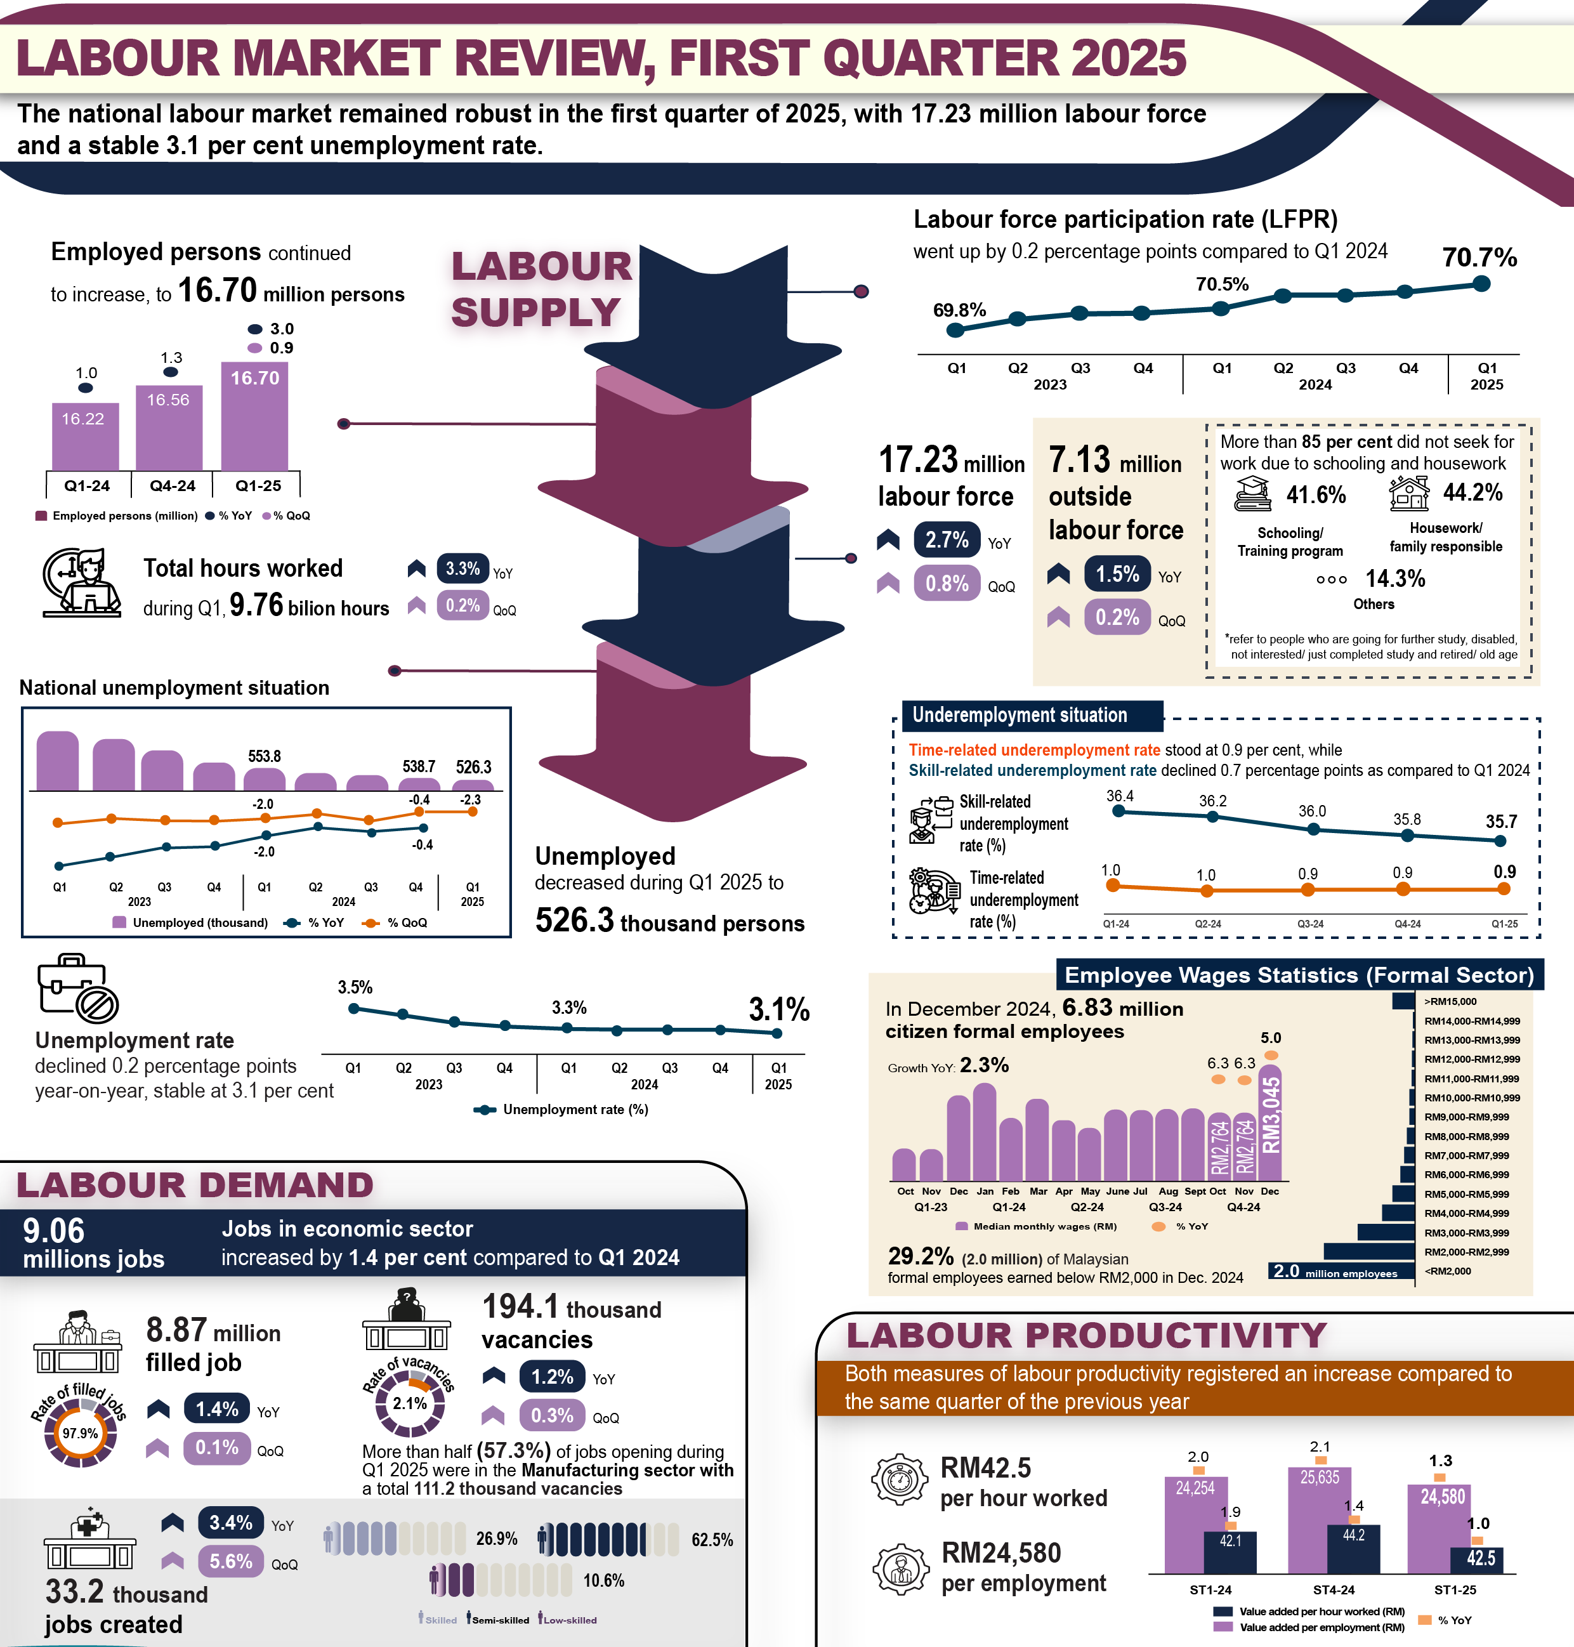

23 MAY 2025 | #101
1

Slide 2

23 MAY 2025 | #101
The national labour market remained robust in the first quarter of 2025, with
17.23 million labour force and a stable 3.1 per cent unemployment rate
In Q1 2025, the labour force strengthened further by 2.7 per cent year-on-year to record 17.23 million persons. Therefore, the labour force participation rate increased by
0.2 percentage points to 70.7 per cent. The number of employed persons continued to increase by 3.0 per cent to 16.70 million persons, with employment-to-population ratio trend up to 68.6 per cent. Concurrently, the number of unemployed persons declined by 5.0 per cent (-27.5 thousand) to 526.3 thousand persons, with an unemployment rate of 3.1 per cent.
The number of employed persons working less than 30 hours per week continued to trend down by 11.1 per cent from Q1 2024 to 242.7 thousand persons, driven by strong domestic demand throughout Q1 2025. Accordingly, the rate of time-related underemployment declined to 0.9 per cent. In the meantime, skill-related underemployment, which comprised more than one-third of employed persons with tertiary education, decreased by 0.7 percentage points to 35.7 per cent in Q1 2025.
Looking at labour demand in the economic sector, the number of jobs grew by
1.4 per cent year-on-year to record a total of 9.06 million jobs. Filled jobs, which comprised 97.9 per cent, also increased by 1.4 per cent over the same quarter of the preceding year to 8.87 million. Meanwhile, job openings in the economy, as indicated by the number of vacancies, rose by 1.2 per cent to 194.1 thousand vacancies during
Q1 2025. Additionally, the number of jobs created in the economic sector rose by
3.4 per cent year-on-year, reaching 33.2 thousand.
Malaysia's economy expanded by 4.4 per cent, while employment sustained its positive growth, labour productivity as measured by value added per employment posted an increase of 1.3 per cent registering the level of RM24,580 per person in Q1 2025. During the same period, total hours worked surged by 3.3 per cent to 9.76 billion hours. Thus, labour productivity per hour worked grew 1.0 per cent to bring the level of productivity to RM42.5 per hour.
Malaysia’s labour market remained resilient, underpinned by stable domestic activity and sustained government policies. Growth in manufacturing, services, and robust domestic demand has contributed to a favourable economic environment, along with initiatives such as investment incentives and infrastructure development, continued to boost market confidence. These factors are expected to support employment creation, especially in high-skilled sectors, and contribute to household income enhancement. However, labour market prospects remain sensitive to external conditions, including the global trade dynamics, commodity price fluctuations, and regional geopolitical risks.
2

